Slide 1


Slide 2
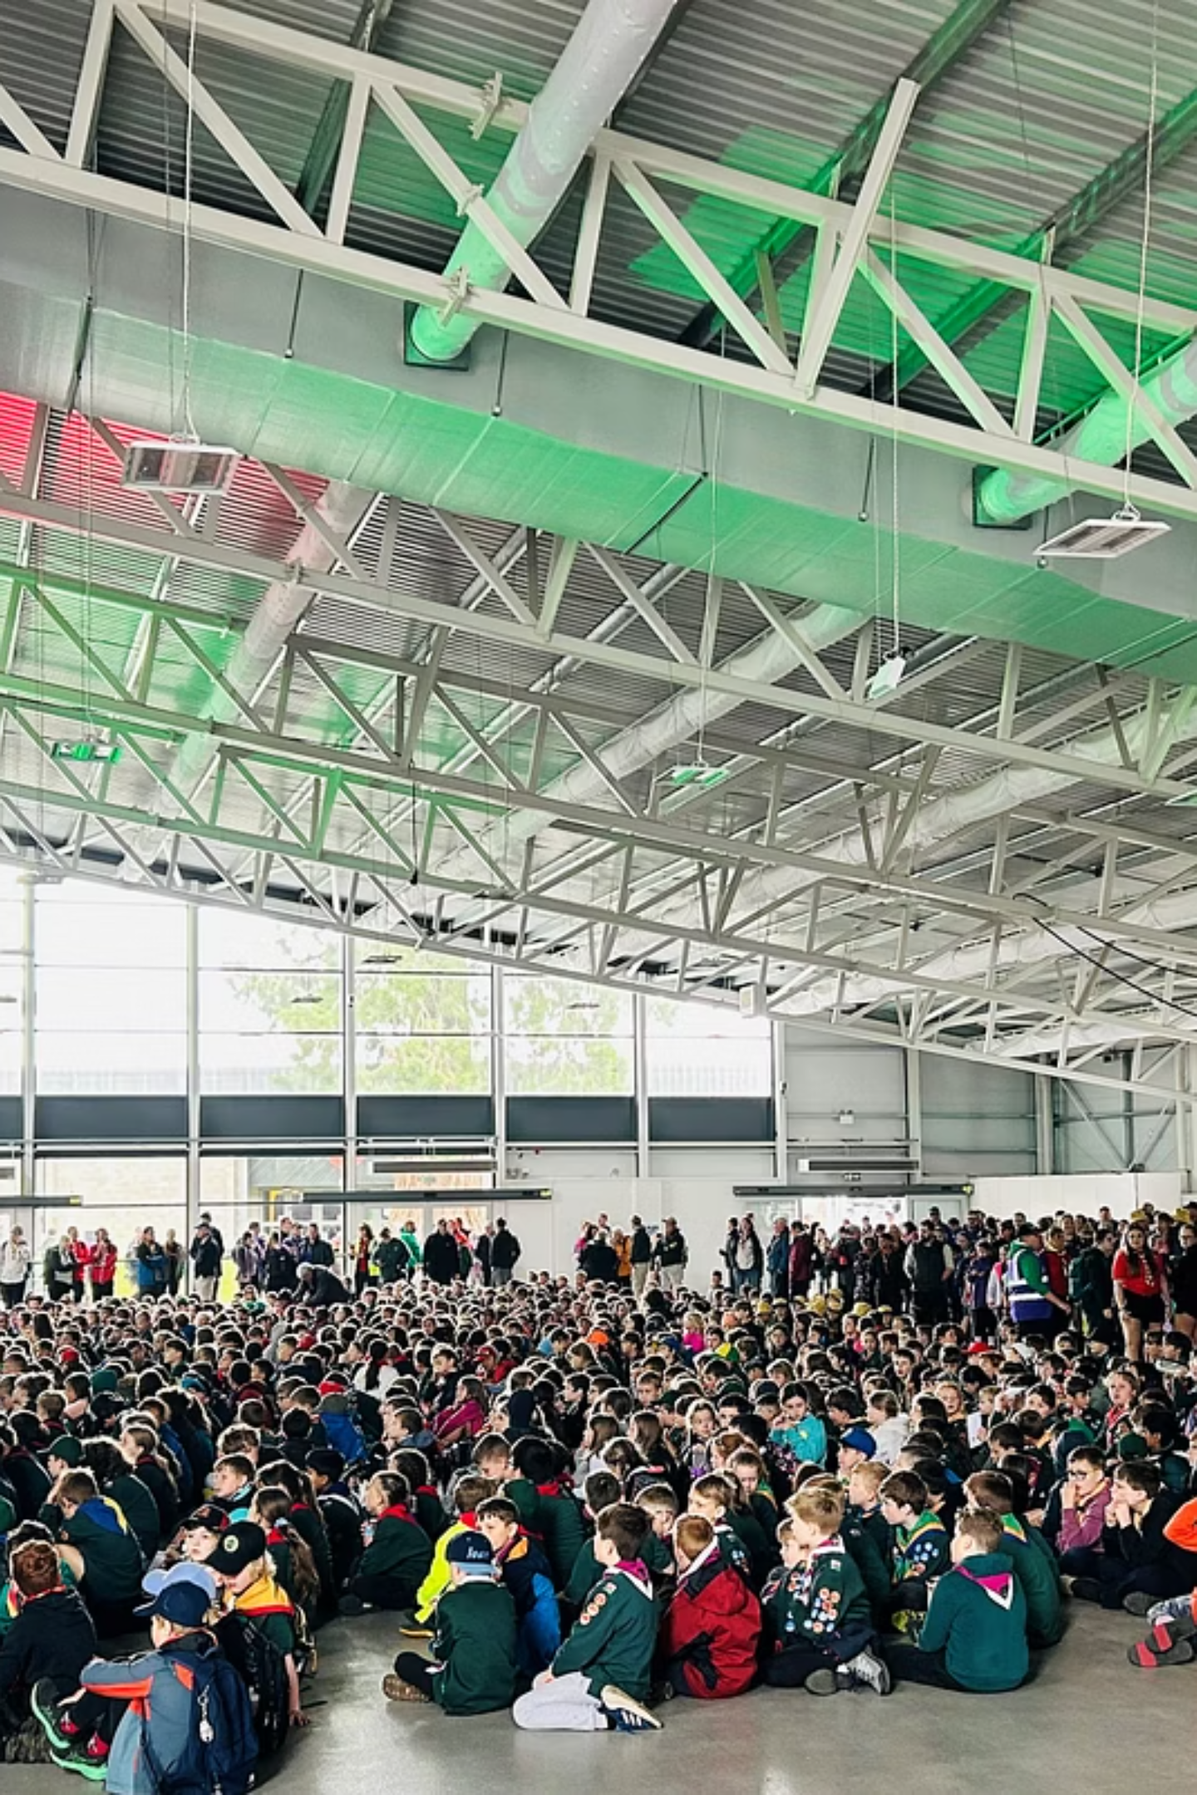
Skills for Life: Shaping a Better Wales
Welcome to ScoutsCymru – where young people of all backgrounds develop skills, build confidence, and create positive change across Wales.
This presentation explores how our inclusive movement supports nearly 14,000 young people through the dedication of over 4,600 volunteers.

Slide 3
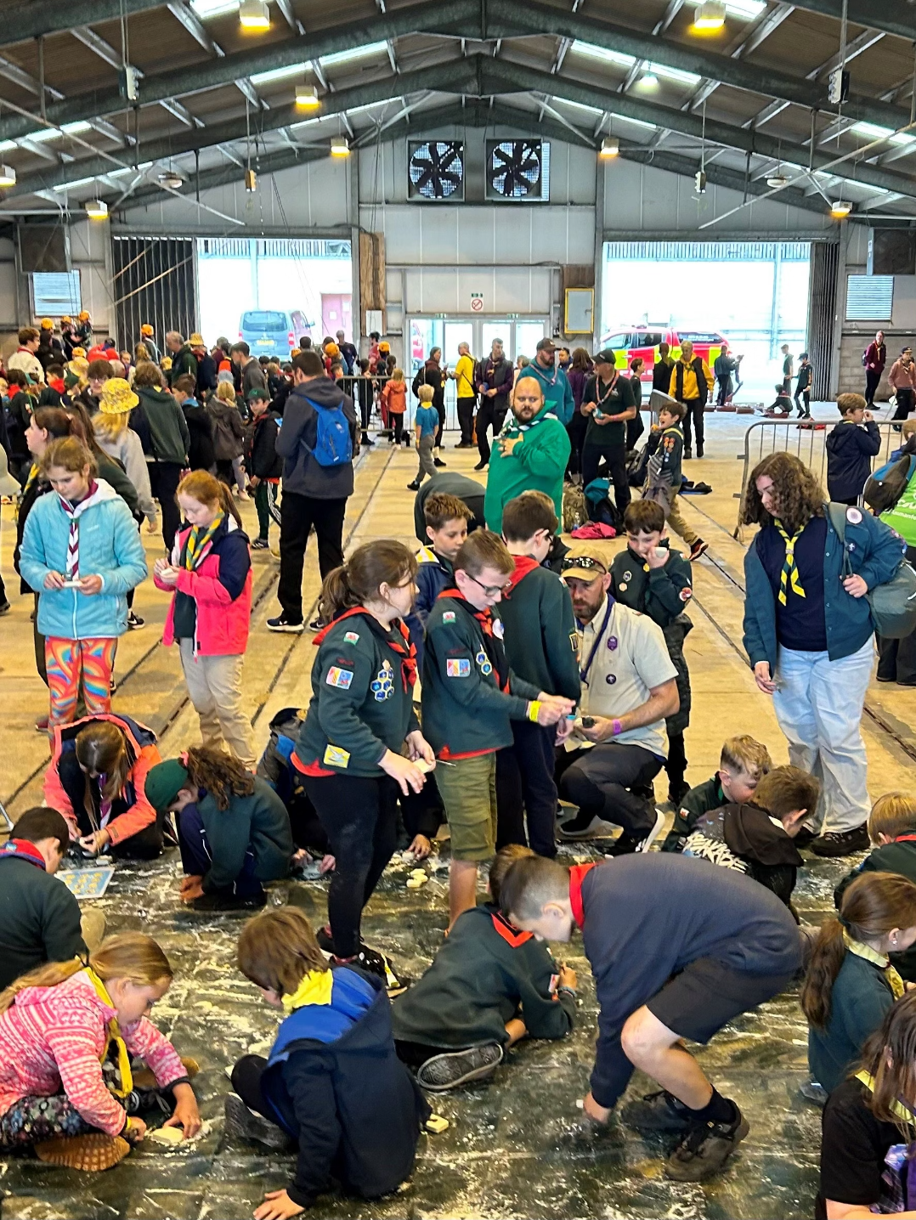
A Welcoming Movement for Everyone
ScoutsCymru proudly welcomes young people from all walks of life.
Our inclusive approach has created a diverse community where:
Almost 14,000 young people participate across Wales
More than a third of our members are girls
27% of members are Welsh speakers
Activities are delivered in both Welsh and English
We offer purpose, belonging, connection and adventure - helping young people grow into active citizens, ready to lead, serve and make a difference wherever they go.

Slide 4






The Power of Volunteering
Personal Benefits
70% report improved life satisfaction
66% experience growth in self-esteem
42% report reduced feelings of loneliness
Why People Volunteer:
"I wanted to improve things and help people“
"To use my existing skills“
"Someone asked me to help"
Our Volunteer Community
4,600+ adult volunteers across Wales
53% are women
Nearly half volunteer outside Scouts too

Slide 5
From Squirrels to Network: Our Journey
Squirrels (ages 4-6)
67 Dreys with 823 members. Action-packed sessions full of games, stories, crafts and outdoor adventures – the perfect introduction to Scouts.
Beavers (ages 6-8)
242 Colonies where curious, kind children explore the world through nature trails, creative crafts, and team activities.
Cubs (ages 8-10½)
261 Packs offering adventures from hikes and camps to science experiments and community projects.
Scouts (ages 10½-14)
241 Troops where young people enjoy outdoor adventures and learn practical skills like cooking and first aid.
Explorers (ages 14-18)
97 Units where members take on real responsibility, from planning expeditions to leading community projects.
Network (ages 18-25)
23 groups offering flexible opportunities to grow, connect, and give back while gaining real-world experience.

Slide 6
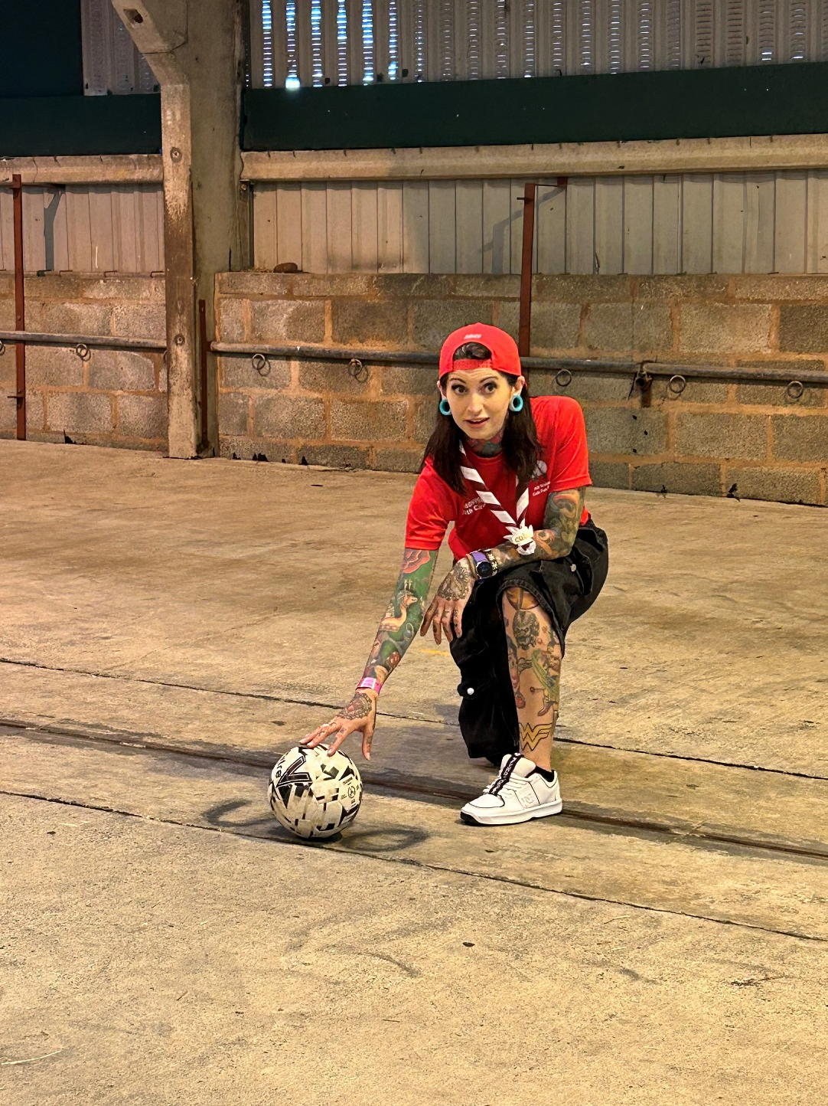
Building Skills for Life
94%
88%
Skills Development
New Experiences
of Scouts say they've developed skills useful in later life
have tried activities they've never done before
200+
Activities Offered
from camping and coding to drama, water-zorbing and bushcraft
Scouts consistently report feeling more confident, more connected, and better prepared to lead in all aspects of life.

Slide 7

Our Welsh Identity
We celebrate our Welsh heritage through our programmes, while also preparing young people to thrive as global citizens through international
opportunities and cross-cultural learning.
Uniquely Welsh
Programmes delivered in both Welsh and English
Special Welsh badges including the Dragon Award
Democracy Challenge reflecting Welsh civic values
RNLI Water Awareness Badge for coastal safety
Adventure Destinations
Cornel and Yr Hafod sites in Eryri National Park
SWAT - Our dedicated Water Activities team
International events like World Scout Jamboree
Local expeditions across Wales's diverse landscapes

Slide 8
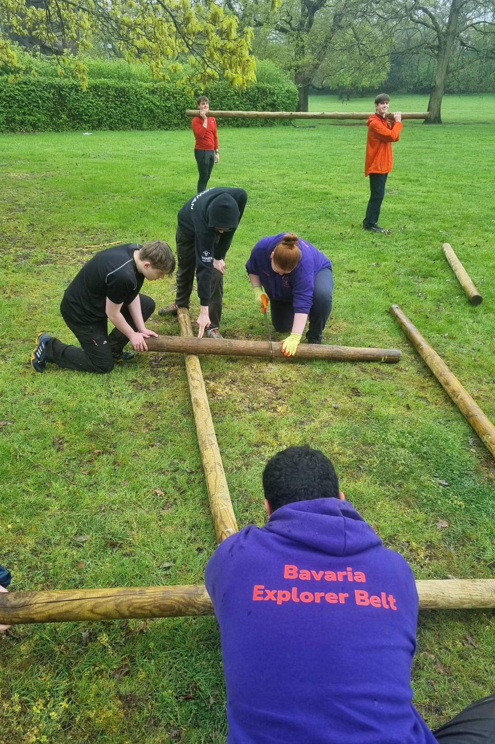



The Impact of Scouting
Values-Led
Public Recognition
Our five values – integrity, respect, care, belief and cooperation – guide everything we do, helping young people develop strong moral compasses for life.
9 out of 10 parents believe their child would benefit from learning skills for life, and 8 out of 10 believe Scouts helps develop those skills.
Growing Demand
Over 4,487 young people are on waiting lists to join Scouts in Wales – part of a 100,000-strong list across the UK. Squirrel Scouting grew by 22% last year alone.

Slide 9
Local Delivery
You can use this slide to include any local info that you’d like to highlight
X
X
X
X
You can use more text or a photo in here
Or just play about with the format and include
whatever you need to.
The sub heading’s are Aptos size 24
The font swaps between Aptos size 20 or 24
depending on the amount you have to say
xx
xx
xx

Slide 10
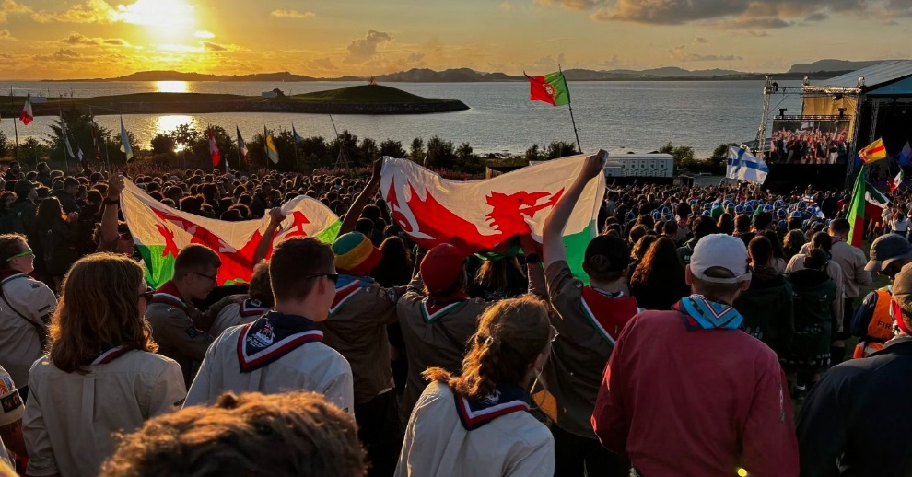
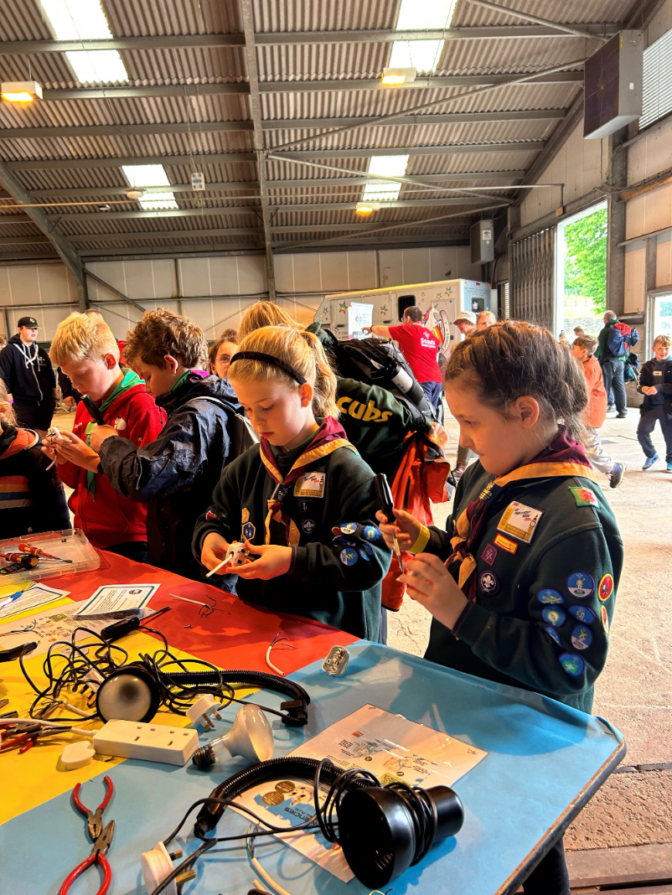
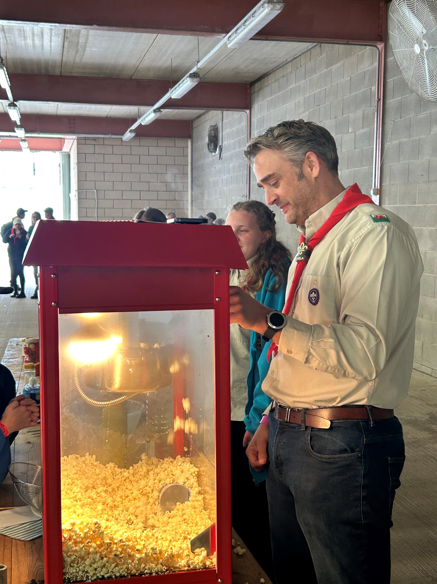

Join Us in Shaping a Better Wales
“Scouting gives me so much joy in learning things and sharing what I know with others. I want to stay for as long as I can, volunteering and supporting younger members."
– Explorer Scout, from 'Youth Voices: Shaping the future of Scouting in Wales' research
Scouts have stood on Everest, walked on the moon, and reached the South Pole. But we're most proud of what's happening every week across Wales – where young people are gaining confidence, building friendships, and working together to shape a more equal, connected and hopeful future.

Slide 11

Stay Connected
Insert your local area’s contact details here
(e.g. email, phone number, local social media)
Xxxxxx
Xxxxxx
Xxxxxx
Xxxxxxx
Follow ScoutsCymru on Facebook, Instagram and LinkedIn
Or contact us at:
📧 admin@scoutscymru.org.uk

